Slide 1
Information Technology Auditing
Introduction
The Audit Function
The IT Auditor’s Toolkit
Auditing Computerized AIS
IT Auditing Today

Slide 2
Introduction
Audits of AISs
Ensure controls are functioning properly
Confirm additional controls not necessary
Nature of Auditing
Internal and external auditing
IT Audit and financial audit
Tools of an IT auditor

Slide 3
The Audit Function
Internal versus External Auditing
Information Technology Auditing
Evaluating the Effectiveness of Information Systems Controls

Slide 4
Internal Auditing
Responsibility of Performance
Company’s own employees
External of the department being audited
Audit Purpose
Employee compliance with policies and procedures
Development and evaluation of internal controls

Slide 5
External Auditing
Responsibility of Performance
Those outside the organization
Accountants working for independent CPA
Audit Purpose
Performance of the attest function
Evaluate the accuracy and fairness of the financial statements relative to GAAP

Slide 6
Information Technology Auditing
Function
Evaluate computer’s role in achieving audit and control objectives
Assurance Provided
Data and information are reliable, confidential, secure, and available
Safeguarding assets, data integrity, and operational effectiveness

Slide 7
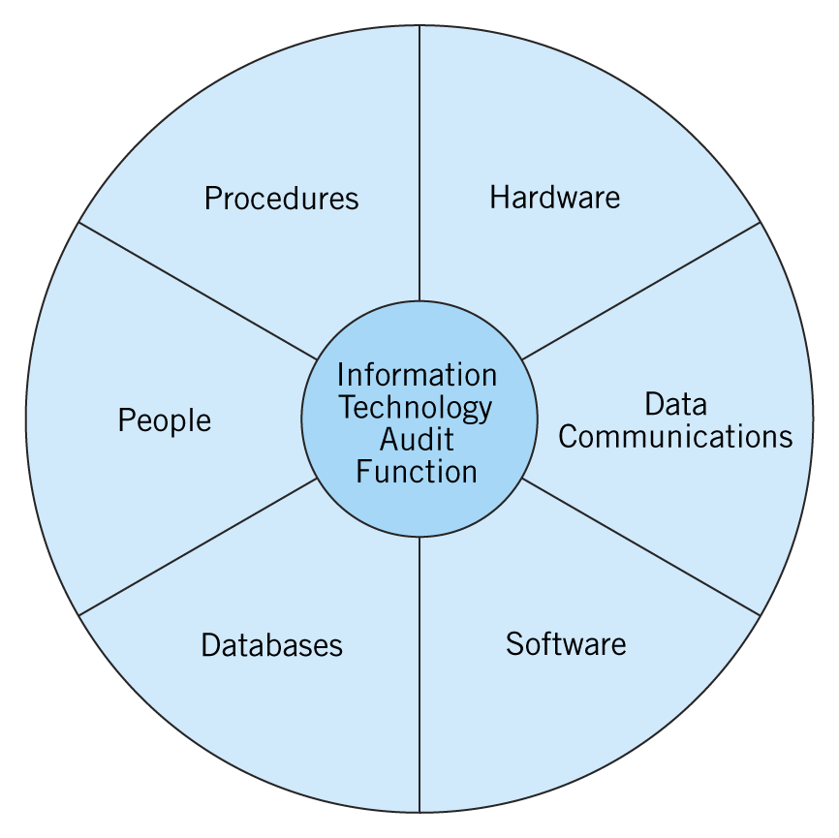
The Components of an IT Audit

Slide 8
The IT Audit Process
Computer-Assisted Audit Techniques (CAAT)
Use of computer processes to perform audit functions
Performing substantive tests
Approaches
Auditing through the computer
Auditing with the computer

Slide 9
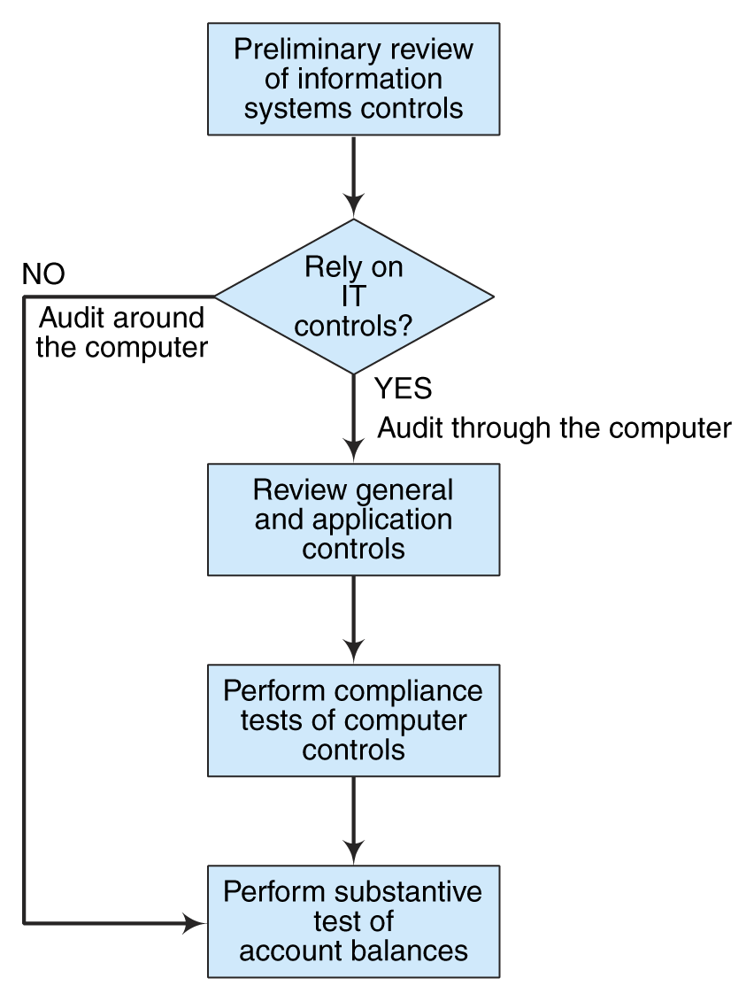
The IT Audit Process

Slide 10
Evaluating the Effectiveness of Information Systems Controls
Impact on Substantive Testing
Strong controls, less substantive testing
Weak controls, more substantive testing
Risk Assessment
Evaluate the risks associated with control weaknesses
Make recommendations to improve controls

Slide 11
Risk Assessment
Risk-Based Audit Approach
Determine the threats
Identify the control procedures needed
Evaluate the current control procedures
Evaluate the weaknesses within the AIS
Benefits
Understanding of errors and irregularities
Sound basis for recommendations

Slide 12
Information Systems Risk Assessment
Method of evaluating desirability of IT controls
Types of Risks
Loss of company secrets
Unauthorized manipulation of company files
Interrupted computer access
Penetration Testing

Slide 13
Guidance is Designing and Evaluating IT Controls
Systems Auditability and Control Report (SAC)
Electronic Systems Assurance and Control (eSAC)
Framework for evaluating e-business controls
Control Objectives for Information and Related Technology (COBIT)

Slide 14
The IT Auditor’s Toolkit
Utilization of CAATs
Auditing with the computer
Manual access to data stored on computers is impossible
Tools
Auditing Software
People Skills

Slide 15
General-Use Software
Productivity tools that improve the auditor’s work
Types
Word processing programs
Spreadsheet software
Database management systems (DBMS)
Structured Query Language (SQL)

Slide 16
Generalized Audit Software
Overview
Allow for reviewing of files without rewriting processing programs
Basic data manipulation
Tailored to auditor tasks
Common Programs
Audit Command Language (ACL)
Interactive Data Extraction and Analysis (IDEA)

Slide 17
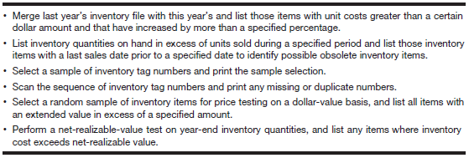
Generalized Audit Software - Inventory

Slide 18
Automated Workpaper Software
Overview
Similar to general ledger software
Handles accounts from many organizations
Features
Generate trial balances
Make adjusting entries
Perform consolidations
Conduct analytical procedures

Slide 19
People Skills
Examples
Working as a team
Interact with clients and other auditors
Interviewing clients
Importance of Interviews
Gain understanding of organization
Evaluate internal controls

Slide 20
Auditing Computerized AISs
Auditing Around the Computer
Assumes accurate output verifies proper processing
Not effective in a computerized environment
Auditing Through the Computer
Follows audit trail through the computer
Verifies proper functioning of processing controls in AIS programs

Slide 21
Auditing Computerized AISs
Testing Computer Programs
Validating Computer Programs
Review of Systems Software
Validating Users and Access Privileges
Continuous Auditing

Slide 22
Testing Computer Programs
Test Data
Create set of transactions
Covering range of exception situations
Compare results and investigate further
Integrated Test Facility
Establish a fictitious entity
Enter transactions for that entity
Observe how they are processed

Slide 23
Testing Computer Programs
Parallel Simulation
Utilized live input data
Simulates all or some of the operations
Compare results
Very time-consuming and cost-prohibitive

Slide 24
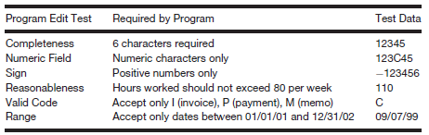
Edit Tests and Test Data

Slide 25
Validating Computer Programs
Tests of Program Change Controls
Protect against unauthorized program changes
Documentation of requests for program changes
Utilize special forms for authorization
Program Comparison
Test of Length
Comparison Program

Slide 26
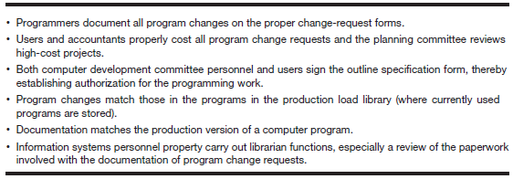
Reviewing a Responsibility System

Slide 27
Review of Systems Software
Systems Software Controls
Operating system software
Utility programs
Program library software
Access control software
Inspect Outputs
Logs
Incident reports

Slide 28
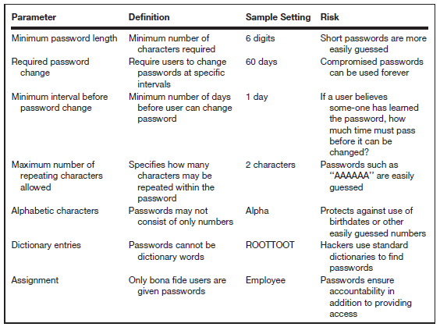
Password Parameters

Slide 29
Validating Users and Access Privileges
Purpose
Ensure all system users are valid
Appropriate access privileges
Utilize Software Tools
Examine login times
Exception conditions
Irregularities

Slide 30
Continuous Auditing
Embedded Audit Modules (Audit Hooks)
Capture data for audit purposes
Exception Reporting
Transactions falling outside given parameters are rejected
Transaction Tagging
Certain transactions tagged and progress recorded

Slide 31
Continuous Auditing
Snapshot Technique
Examines how transactions are processed
Continuous and Intermittent Simulation (CIS)
Embeds audit module in a database management system (DBMS)
Similar to parallel simulation

Slide 32
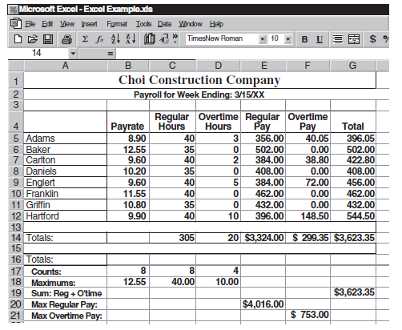
Continuous Auditing – Spreadsheet Errors

Slide 33
IT Auditing Today
IT Governance
Auditing for Fraud: Statement on Auditing Standards No. 99
The Sarbanes-Oxley Act of 2002
Third Party and Information Systems Reliability Assurances

Slide 34
IT Governance
Overview
Process of using IT resources effectively
Efficient, responsible, strategic use of IT
Objectives
Using IT strategically to fulfill mission of organization
Ensure effective management of IT

Slide 35
Auditing for Fraud: Statement on Auditing Standard No. 99
Overview
Supersedes SAS No. 82
Provides more guidance to prevent and deter fraud
Fraud Triangle
Motive for committing fraud
Opportunity that allows fraud to occur
Rationalization by individual

Slide 36
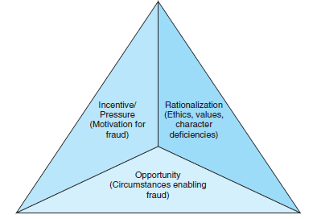
Fraud Triangle

Slide 37
The Sarbanes-Oxley Act of 2002
Overview
Limits services that auditors can provide clients while they are conducting audits
Groups of Compliance Requirements
Audit committee/corporate governance requirements
Certification, disclosure, and internal control
Financial statement reporting rules
Executive reporting and conduct

Slide 38
The Sarbanes-Oxley Act of 2002
Section 302
CEOs and CFOs are required to certify the financial statements
Internal controls and disclosures are adequate
Section 404
CEOs and CFOs assess and attest to the effectiveness of internal controls

Slide 39
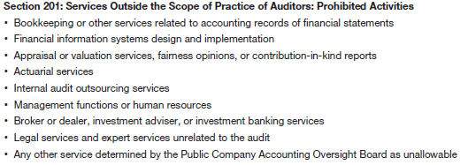
Key Provisions of SOX

Slide 40
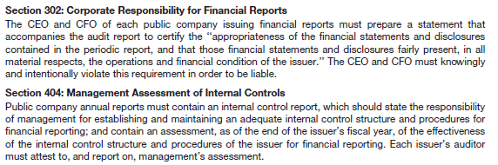
Key Provisions of SOX

Slide 41
Third Party and Information Systems Reliability Assurances
Growth of Electronic Commerce
Area of growing risk
Security and privacy concerns
Difficult to audit
AICPA Trust Services
CPA WebTrust
SysTrust

Slide 42
Third Party and Information Systems Reliability Assurances
Principles of Trust Services
Security
Availability
Processing integrity
Online privacy
Confidentiality

Slide 43
Copyright
Copyright 2010 John Wiley & Sons, Inc. All rights reserved.
Reproduction or translation of this work beyond that permitted in
Section 117 of the 1976 United States Copyright Act without the
express written permission of the copyright owner is unlawful.
Request for further information should be addressed to the
Permissions Department, John Wiley & Sons, Inc. The purchaser may make backup copies for his/her own use only and not for distribution or resale. The Publisher assumes no responsibility for errors, omissions, or damages, caused by the use of these programs or from the use of the information contained herein.

Slide 44
Chapter 14

